Slide 1
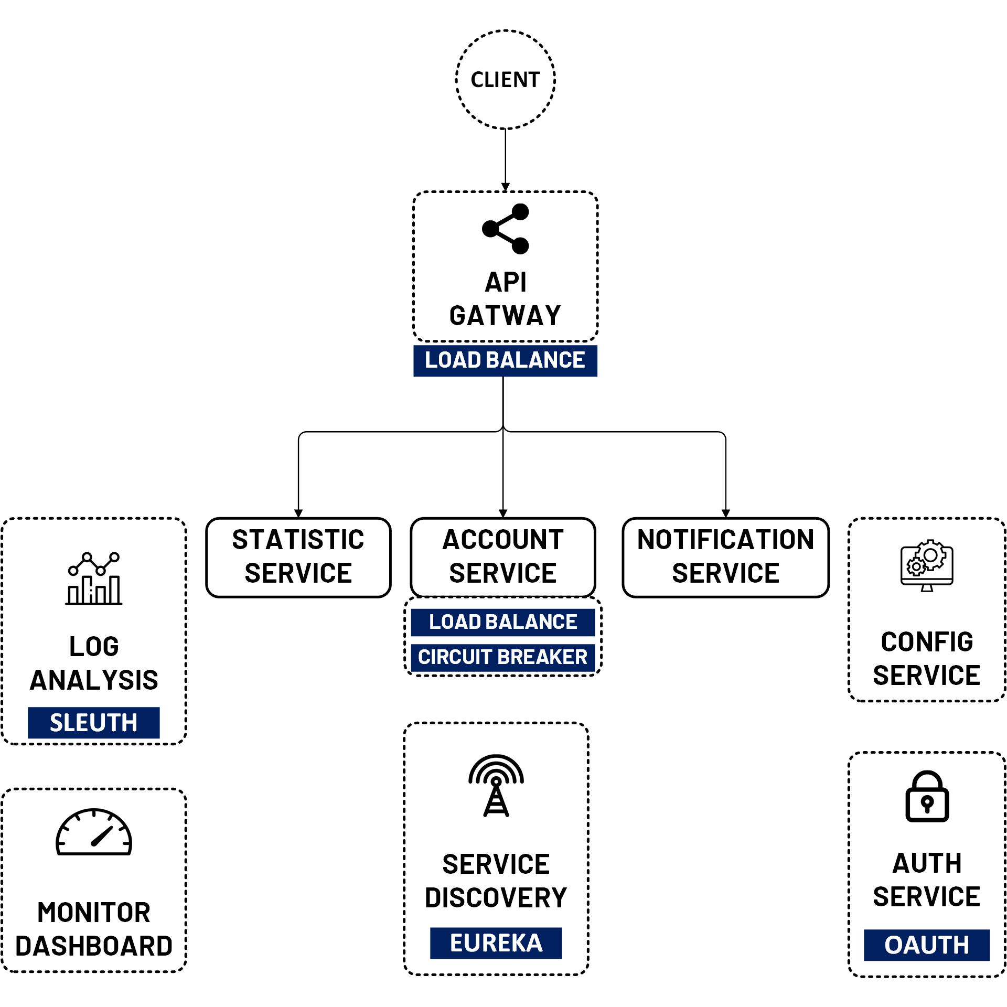

OAuth 2 Security Authorization Code
www.jmaster.io/course/microservices-with-spring-cloud

Slide 2
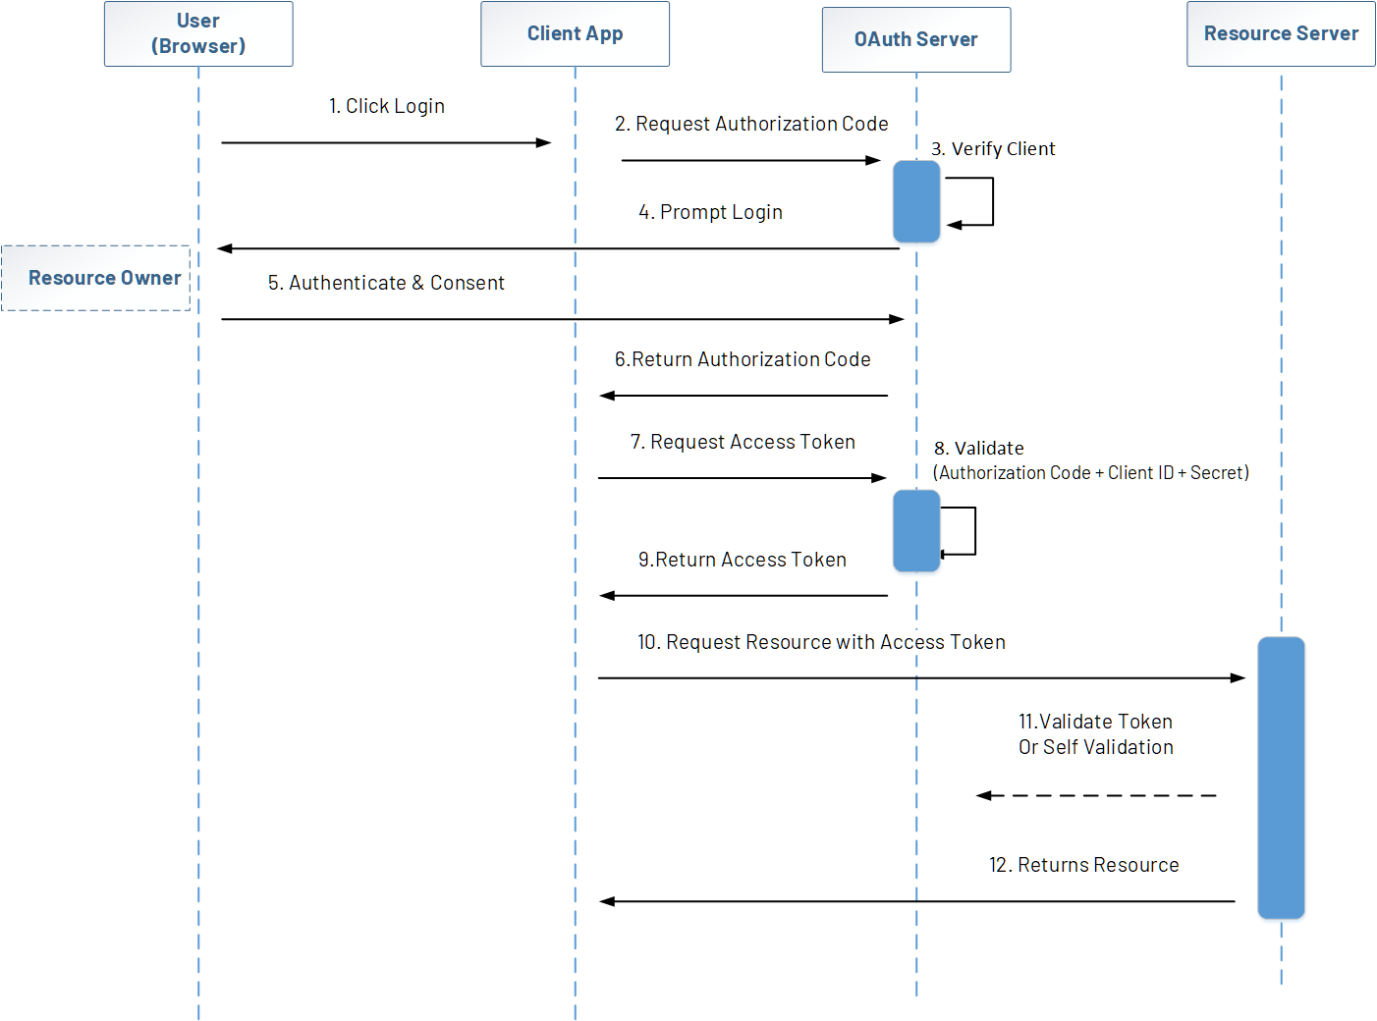

Slide 3
Authorization Server
Open source
Spring Security OAuth2
Spring Authorization Server
Keycloak
Enterprise
Okta
Auth0

